Slide 1
Framework and Data Model for OTN Network Slicing
draft-ietf-ccamp-yang-otn-slicing-00
Co-authors:
Haomian Zheng (Huawei)
Italo Busi (Huawei) Aihua Guo (Futurewei)
Victor Lopez(Nokia)
Sergio Belotti (Nokia)
Dieter Beller (Nokia)
Reza Rokui (Ciena)
Luis M. Contreras (Telefonica)
Oscar Gonzales (Telefonica)
Yunbin Xu (CAICT)
Yang Zhao (China Mobile)
Xufeng Liu (IBM)
Contributors:
Henry Yu (Huawei)
Jiang Sun (China Mobile)

Slide 2
Draft Updates Since IETF 112
Draft Updates
WG adopted with comments to be addressed. Rev-00 was published.
GitHub migrated to CCAMP
https://github.com/ietf-ccamp-wg/ietf-ccamp-yang-otn-slicing
Issues to seek consensus are tracked in GitHub
Discussed comments through the mailing list, weekly meetings and offline calls

Slide 3
Comments Received During WG Adoption
Harmonizing with draft-ietf-teas-ietf-network-slice-nbi-yang #26
Update the text to clarify OTN-SC's role as a NS-realizer w.r.t. IETF NSC #27
Harmonizing with draft-ietf-teas-applicability-actn-slicing #28
Frontpage authors #23
Relationship between an OTN slice and L1VPN #29
Relationship between an OTN slice and an Abstract (TE) Topology #30
Should network slicing stop at the IP layer and is not needed for any circuit-switching layers below (L0/L1/MW)? #31
Should we use "OTN resource partitioning" or "OTN virtual network" instead of "OTN Slicing"? #32
How does OTN slice support p2p, p2mp connectivity constructs #33
Update description of OTN-SC in response to mailing list comments #34
Update the text to amend MPLS with MPLS(-TP) wherever applicable #35
Tom Petch's comment on the draft text in general #36

Slide 4
Comments Received during WG Adoption
Improvements to draft text
Update the text to clarify OTN-SC's role as a NS-realizer w.r.t. IETF NSC #27
Frontpage authors #23
Update description of OTN-SC in response to mailing list comments #34
Update the text to amend MPLS with MPLS(-TP) wherever applicable #35
Tom Petch's comment on the draft text in general #36
Consensus
Harmonizing with draft-ietf-teas-ietf-network-slice-nbi-yang #26
Harmonizing with draft-ietf-teas-applicability-actn-slicing #28
Addressable by TEAS
“Slice” is a conflated term. Should Replace the term “slice” and “IETF network slice” with “VN”, “resource partitioning” or something else.
Why not using the TE topology model or ACTN VN model for configuring network slices at the NBI
IETF NS framework is too premature to be used for OTN slicing
Comments related to OTN Slicing
Relationship between an OTN slice and L1VPN #29
Relationship between an OTN slice and an Abstract (TE) Topology #30
Should network slicing stop at the IP layer and is not needed for any circuit-switching layers below (L0/L1/MW)? #31
Should we use "OTN resource partitioning" or "OTN virtual network" instead of "OTN Slicing"? #32
How does OTN slice support p2p, p2mp connectivity constructs #33

Slide 5
Do we need “slicing” for OTN?
Short answer - YES!
Use cases for slicing in OTN-only networks and IP-over-optical networks; use cases are described in the IETF NS framework as well as in this draft
Network co-sharing & co-construction
Network wholesaling
Network slicing to support private OTN interconnects in vertical industry
E2E network slicing
Many optical vendors have commercial applications available that resemble “OTN slices” – with proprietary interfaces
Standardization of an intent-based interface for OTN slicing is necessary to achieve interoperability
Slicing for OTN is in the scope defined in the IETF NS framework
“A number of use cases benefit from network connections that along with the connectivity provide assurance of meeting a specific set of objectives with respect to network resources use. This connectivity and resource commitment is referred to as a network slice. Since the term network slice is rather generic, the qualifying term "IETF" is used in this document to limit the scope of network slice to network technologies described and standardized by the IETF.”

Slide 6
Intent vs. Realization
Intent – express what a customer needs
Slice expressed as a network topology or connections with measurable SLOs and SLEs
An OTN slice is an intent
Realization – how a slice is realized
Many IETF technologies available for realizing OTN slicing in control and management plane: L1VPN, TE topology, TE tunnel, NMS, Netconf/YANG
Time slot-based hard slicing at the data plane
Missing an intent-based NBI to support OTN slicing within the scope of the IETF NS framework
Slicing for OTN is relatively simpler to realize at data plane. Still, we have to consider
OTN technology-specific SLOs
Signal quality at endpoint and/or path level, e.g. bit error rate, frame jitter
Reinterpretation of generic SLOs
Bandwidth --> # of ODU/sub-ODU time slots
Availability --> protection / restoration
Notes:
SLEs such as isolation perfectly match with the capabilities offered by OTN.

Slide 7

Scenarios for Slice Configuration in OTN Networks
OTN slice service
IETF NS service
IETF NS service
OTN-aware Consumer
IP Service Consumer
IP Service Consumer
OTN-SC NBI
IETF NSC NBI
IETF NSC NBI
OTN-SC
IETF NSC
IETF NSC
OTN SC NBI
IETF NSC SBI
PNC NBI
IETF NSC SBI
PNC NBI
OTN SC
IP Network
OTN Network
OTN Network
IP Network
OTN-only
OTN Network
IP+OTN peering
IP+OTN Multi-layer
OTN-SC NBI (technology-specific) augments the IETF NSC NBI(technology-agnostic
Notes:
- Create two pictures for IP-OTN as peer and in multi-layer configurations

Slide 8
Can We Call it “OTN Slice”?
The concept of “network slicing” is originated from 5G E2E slicing, which assumes an IP-only scenario for packet transport networks
It is the TEAS consensus to solidify the term “slicing” and applies IETF network slicing beyond 5G E2E slicing
Endpoints of an IETF network slice may be non-IP, e.g. OTN
Slice --> IETF Network Slice --> OTN Slice
Unambiguous context under the IETF NS framework
OTN slice is an IETF network slice when the IETF network is known to be OTN
So, the answer is – YES!

Slide 9
OTN Slice and L1VPN
Slicing goes beyond existing VPN services
“Thus, there is a need to create logical network structures with required characteristics. The customer of such a logical network can require a degree of isolation and performance that previously might not have been satisfied by traditional overlay VPNs. Additionally, the IETF Network Slice customer might ask for some level of control of their virtual networks, e.g., to customize the service paths in a network slice.”
An OTN Slice is an intent; L1VPN is a possible realization of an OTN slice; other realizations are also possible (and implemented).
OTN slice : L1VPN = IETF network slice : LxVPN(including VPN+)

Slide 10
OTN Slice and Abstract Topology
An OTN Slice is an intent; Abstract (TE) topology is a possible realization of an OTN slice (RFC8795)
In theory, TE topology might be used to partially express an intent but this is not the direction taken by TEAS WG.
Not all the intent parameters are defined in the TE topology model.
OTN slice : OTN topology = IETF network slice : TE topology

Slide 11
Support for P2P, P2MP and MP2MP in OTN Slicing
P2P and P2MP connections are supported by OTN data plane; MP2MP (any-to-any) connections are not supported by OTN data plane alone
It is operator’s choice for an OTN slice to support only p2p/p2mp services. Not all possible service types need to be supported by an OTN slice.
Support for service features and SLOs are always negotiable between slice consumer and provider.
Whether to build slicing services over OTN or IP (or both) networks is a matter of operational and technical choice

Slide 12
Next Steps
Update the draft text to address comments from the WG
Align and augment ietf-network-slicing-yang
Adding topology description (for resource-based partitioning)
Clean ietf-network-slicing-yang from packet specific parameters
Define OTN technology-specific SLOs

Slide 13
Thank you!

Slide 14
Backup Slides

Slide 15
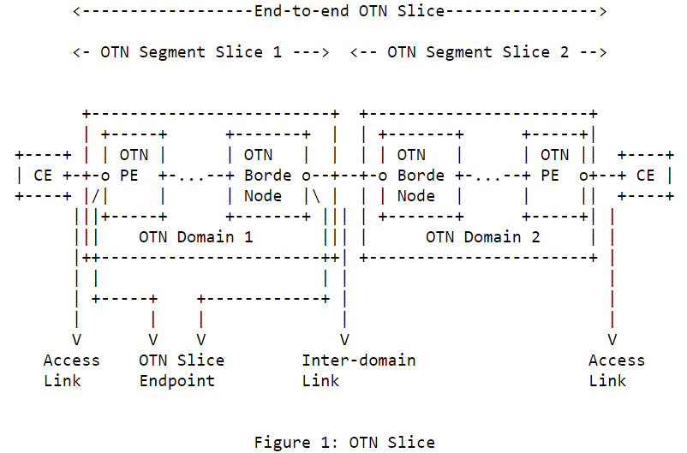
Definition & Scope of OTN Slice
Aligned the definition with IETF network slicing [I-D.ietf-teas-ietf-network-slices]
An OTN slice is an OTN virtual network topology connecting a number of OTN endpoints using a set of shared or dedicated OTN network resources to satisfy specific service level objectives (SLOs).
An OTN slice is a technology-specific realization of an IETF network slice in the OTN domain
Scope of OTN slice for single-domain & multi-domain
Access link – Access link
Access link – Inter-domain link
OTN segment slices in hierarchical or sequential (stitched) combination

Slide 16
Abstraction Method for OTN Slices
Connectivity-based OTN slices are abstracted as a set of endpoint-to-endpoint links, with each link formed by an end-to-end tunnel across the underlying OTN networks
Resource-based OTN slices are abstracted as an abstract topology to allow resource sharing between endpoints, and on-demand commissioning within the slice.
Better optimization of resources
Real world example: OTN slice supporting high-quality, real-time broadcasting of sports events between multiple stadiums and TV station
The methods are similar to the Virtual Network (VN) concept defined in RFC8453
VN type 1 – connectivity-based slicing
VN type 2 – resource-based slicing

Slide 17
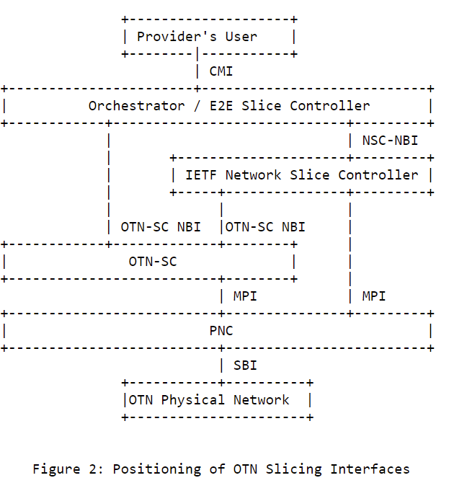
OTN Slicing Controller & Interfaces
OTN Slice Controller (OTN-SC)
A logical function responsible for the life-cycle management of OTN slices instantiated within the corresponding OTN network domains
Translating slice configuration into TE tunnels or TE abstract topologies with resource coloring at the MPI
Flexible deployment
Recursive
OTN-SC NBI
Serves orchestrator for direct OTN slice requests
An IETF NSC has the option to use OTN-SC NBI or directly interface with PNC/MDSC to realize slices
OTN-SC SBI
SBI clients: ACTN PNC / MDSC

Slide 18
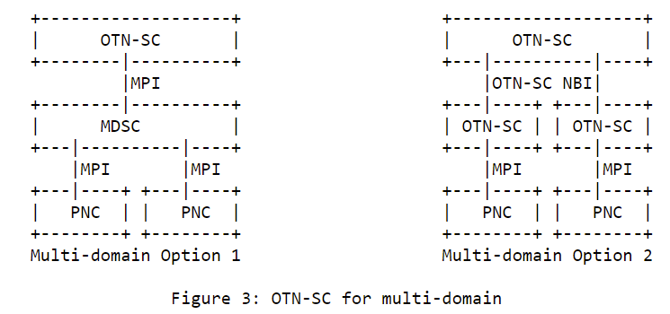
OTN Slicing for Multi-domain
OTN-SC – OTN-SC recursion
OTN-SC – MDSC – PNC

Slide 19
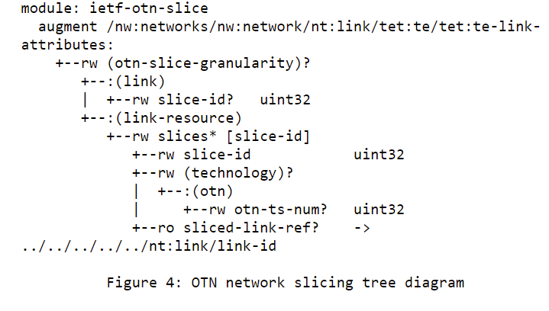
YANG Models @ MPI
Coloring TE links
Either type/number of ODU containers or number of time slots could be used for coloring TE link resources at the MPI
* A prior version of this YANG model was contributed to ONAP and is included in its Guilin Release.

Slide 20
Next Steps
Continue updating the YANG model for OTN-SC SBI (i.e. MPI in Fig. 2)
Develop YANG model for OTN-SC NBI. Looking into related work, e.g.
draft-liu-teas- transport-network-slice-yang
draft-wd-teas-transport-slice-yang for NBI towards the orchestrator
draft-contreras-teas-slice-controller-models
draft-ietf-teas-actn-vn-yang
Address the slicing for external (access and inter-domain) links that support client signals other than OTN
Address comments and reviews from the WG
The authors believe the draft is ready for WG adoption
Consensus on the definition & scope among authors
Good interest
Stable YANG MPI and clear development path for NBI

